Slide 1



Layouts and Fragments

Slide 2
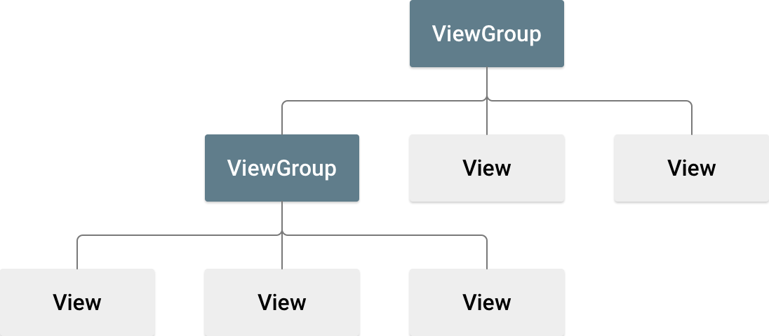
Introduction
The app is a combination of View and ViewGroup objects.
View objects draw item (Widgets) that users can see and interacts with.
ViewGroup objects create invisible containers that define the layout structure of the View object.
Layout can be created by:
As an XML definition [drag and drop in the layout editor].
Programmatically during the runtime.
~Courtesy: developer.android.com

Slide 3
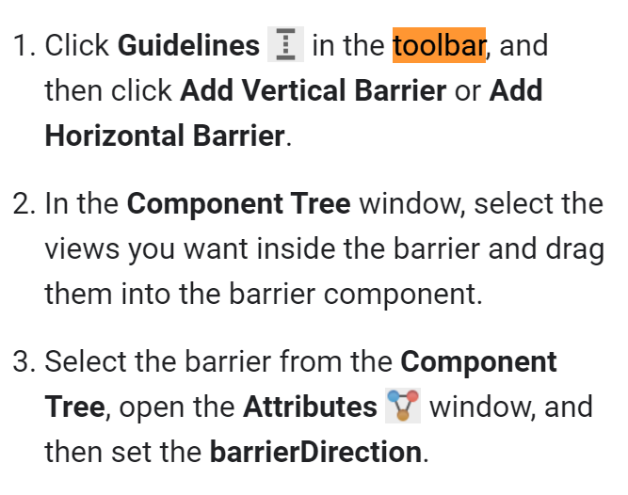
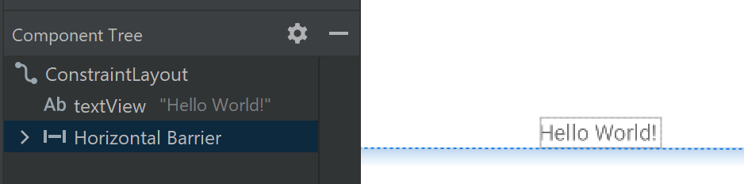
ConstraintLayout
A Flat layout that has no nested ViewGroups.
The Views will be aligned relatively to each others position or to the parent layout.
The can also be aligned to a barrier.

Slide 4
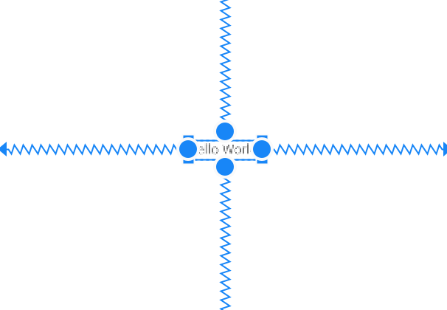
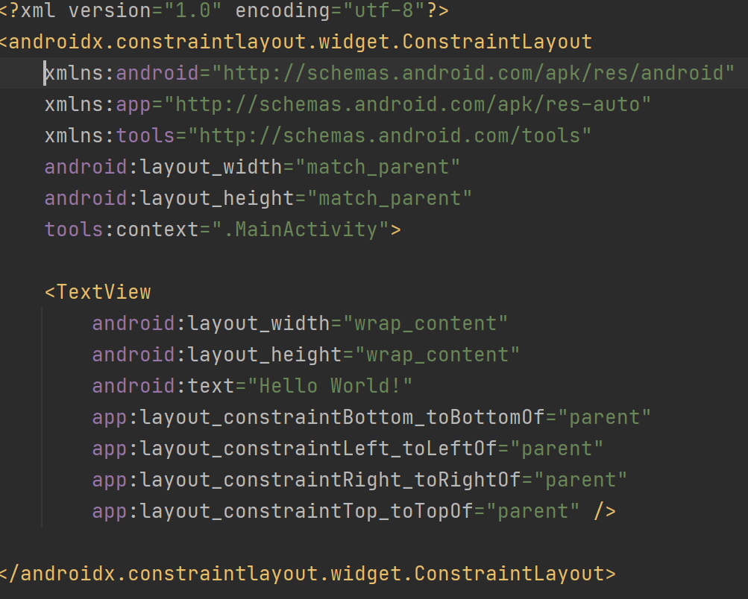
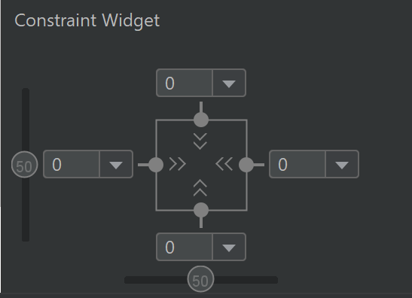
ConstraintLayout

Slide 5
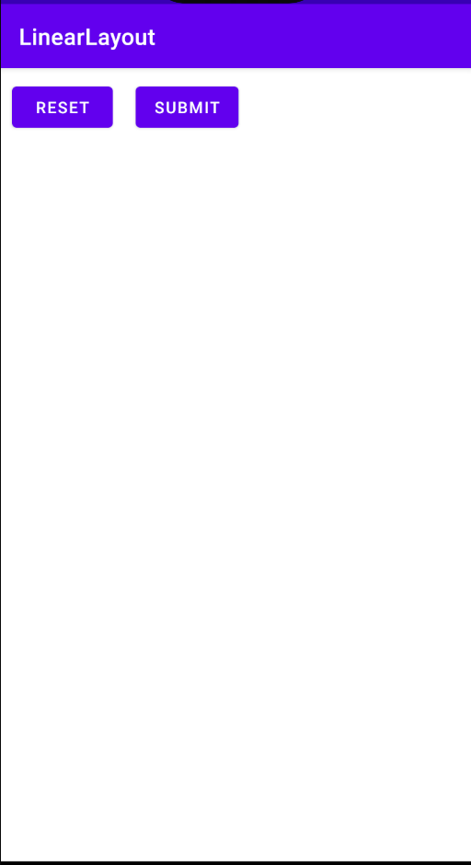
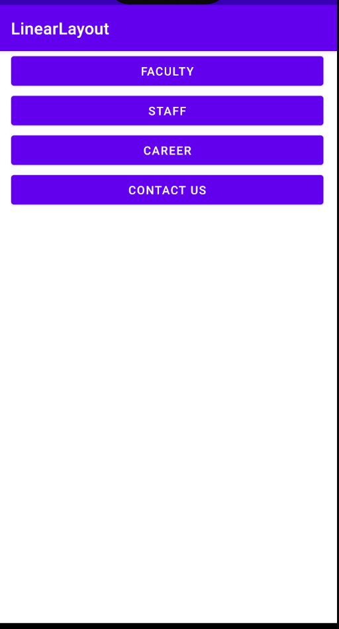
LinearLayout
Layout can align it is own children in one direction (Vertical, Horizontal).
Horizontal
Vertical

Slide 6
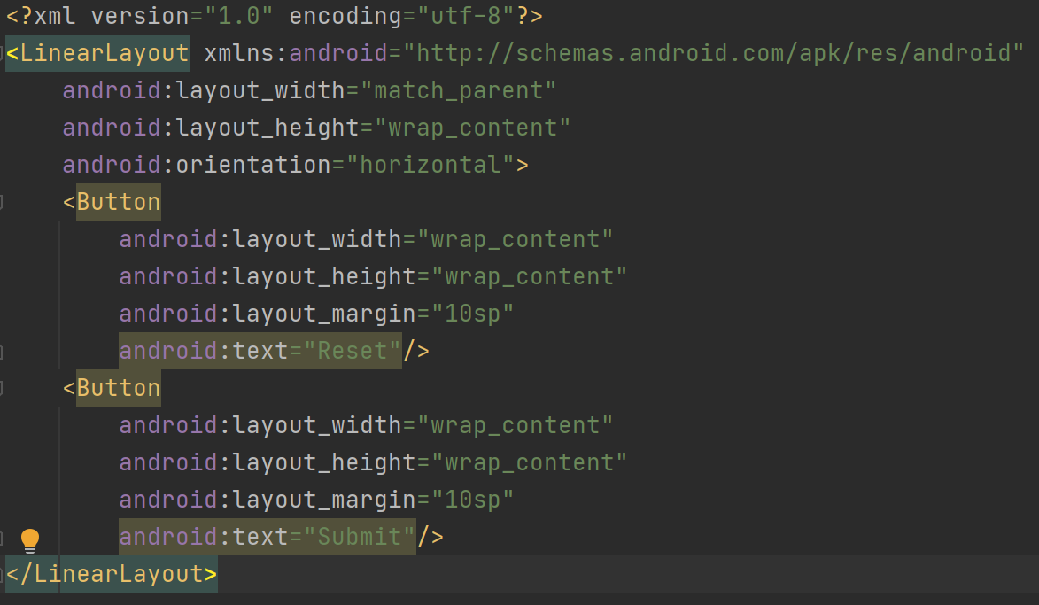
Horizontal Layout

Slide 7
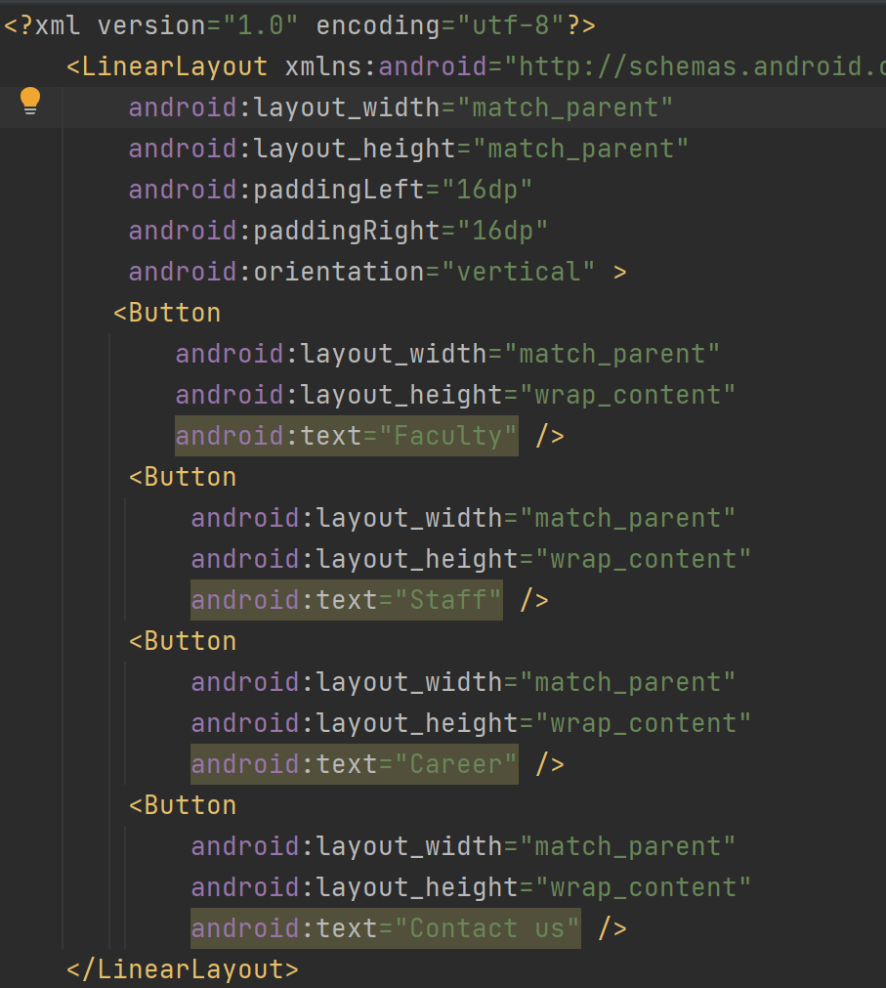
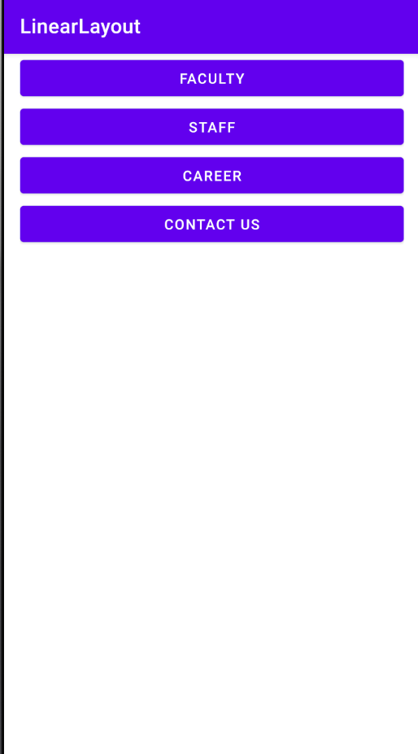
Vertical Layout

Slide 8
Fragment
A Fragment represents a reusable portion of your app's UI.
The fragment has it is own events.
Fragment must be hosted by an activity, they can not be living by their own.
Fragments introduce modularity and reusability into your activity’s UI by allowing you to divide the UI into discrete chunks.

Slide 9
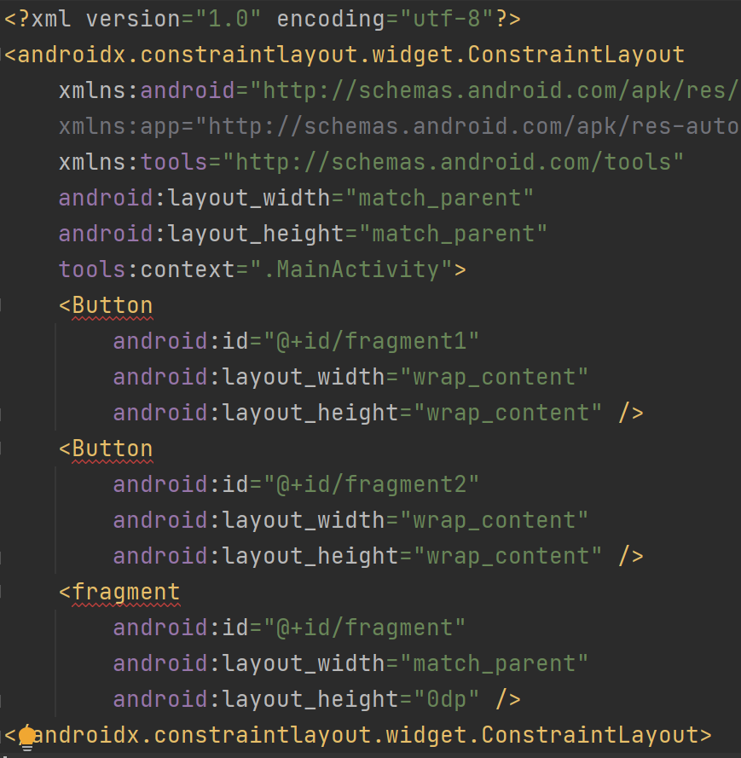
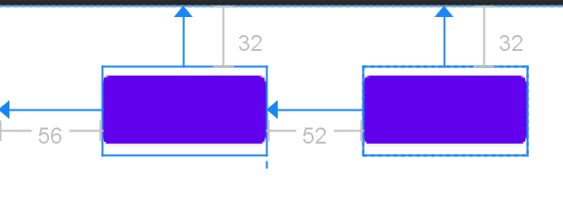
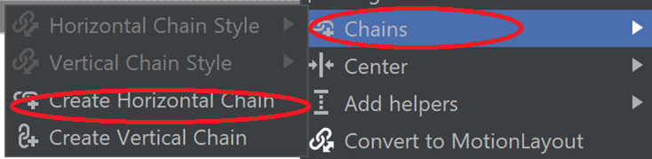
Fragment
Create an Empty Activity app with the name “Fragments”.
In activity_main.xml, create the following as in the left:
Then, click the design mode, scatter the button and create the following constraints:
Select both button, right click then select chain->create horizontal chain

Slide 10
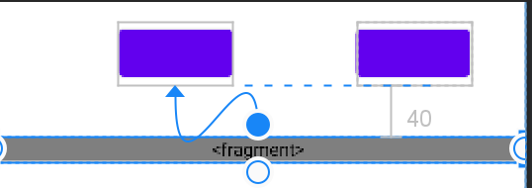
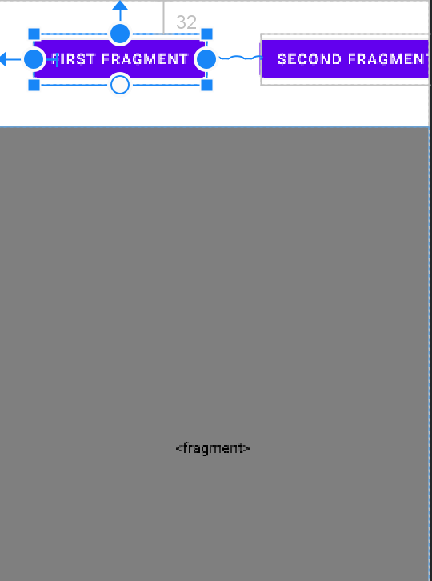
Fragment
Constraint the fragment top to the bottom of the first button
Constraint the fragment bottom to the bottom of the parent frame (down)
Add text to the buttons
The result

Slide 11
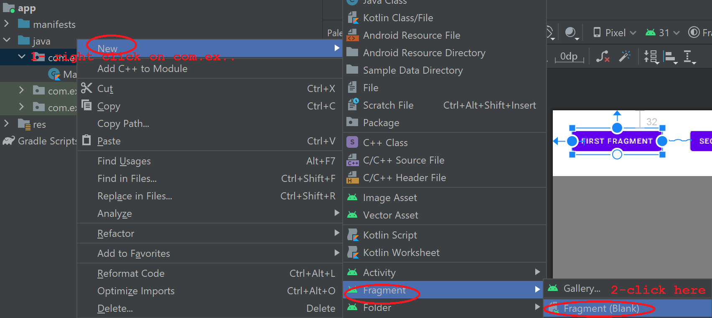
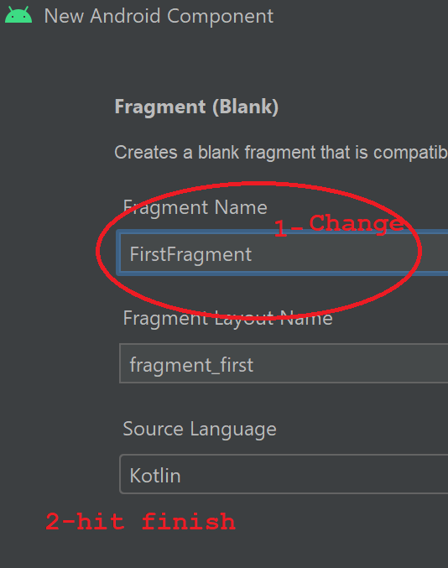

Create Fragement Class
The result

Slide 12
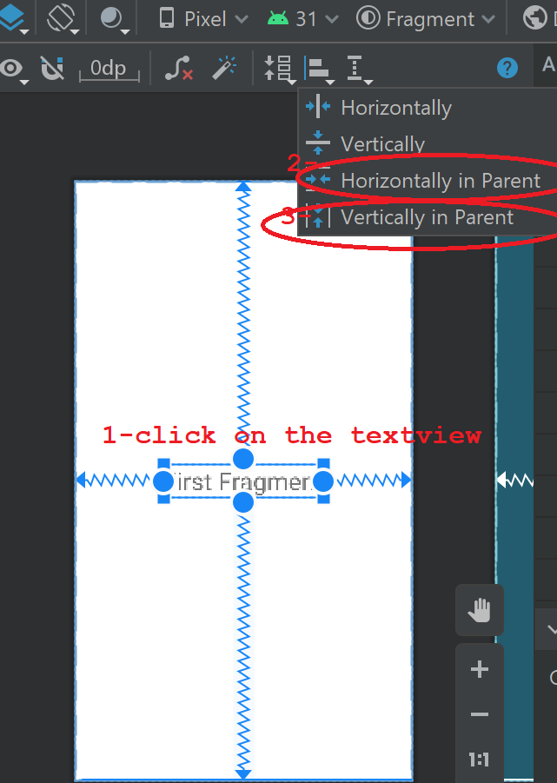
Fragment_first.XML
<?xml version="1.0" encoding="utf-8"?> <androidx.constraintlayout.widget.ConstraintLayout
xmlns:android="http://schemas.android.com/apk/res/android" xmlns:app="http://schemas.android.com/apk/res-auto" xmlns:tools="http://schemas.android.com/tools" android:layout_width="match_parent" android:layout_height="match_parent" tools:context=".FirstFragment"> <!-- TODO: Update blank fragment layout --> <TextView android:id="@+id/tvFirstFragment" android:layout_width="wrap_content" android:layout_height="wrap_content" android:text="First Fragment" android:textSize="30sp" app:layout_constraintTop_toTopOf="parent" /> </androidx.constraintlayout.widget.ConstraintLayout>

Slide 13
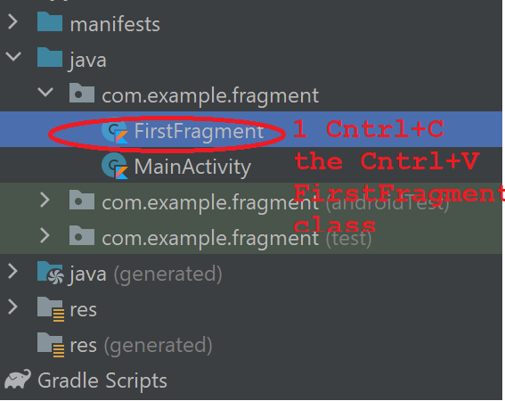
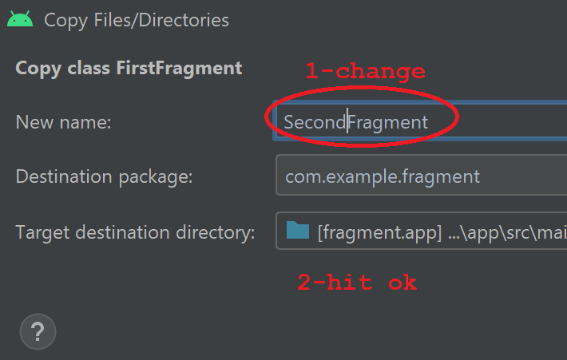
FirstFragment.kt then copy+paste the class
class FirstFragment : Fragment(R.layout.fragment_first) { //clean off this class }
Add the fragment id to the constructor of the fragment

Slide 14
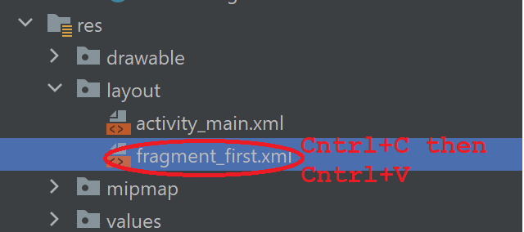
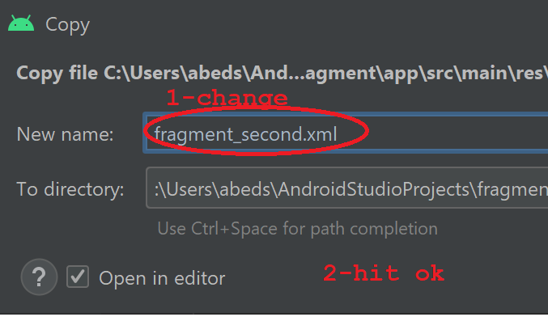
Copy+Paste the XML

Slide 15
Fragment_second.XML & SecondFragment.kt
<?xml version="1.0" encoding="utf-8"?> <androidx.constraintlayout.widget.ConstraintLayout
xmlns:android="http://schemas.android.com/apk/res/android" xmlns:app="http://schemas.android.com/apk/res-auto" xmlns:tools="http://schemas.android.com/tools" android:layout_width="match_parent" android:layout_height="match_parent" tools:context=".FirstFragment"> <!-- TODO: Update blank fragment layout --> <TextView android:id="@+id/tvSecondFragment" android:layout_width="wrap_content" android:layout_height="wrap_content" android:text="Second Fragment" android:textSize="30sp" app:layout_constraintBottom_toBottomOf="parent" app:layout_constraintEnd_toEndOf="parent" app:layout_constraintHorizontal_bias="0.5" app:layout_constraintStart_toStartOf="parent" app:layout_constraintTop_toTopOf="parent" /> </androidx.constraintlayout.widget.ConstraintLayout>
package com.example.fragment import android.os.Bundle import androidx.fragment.app.Fragment import android.view.LayoutInflater import android.view.View import android.view.ViewGroup class SecondFragment : Fragment(R.layout.fragment_second) { }

Slide 16
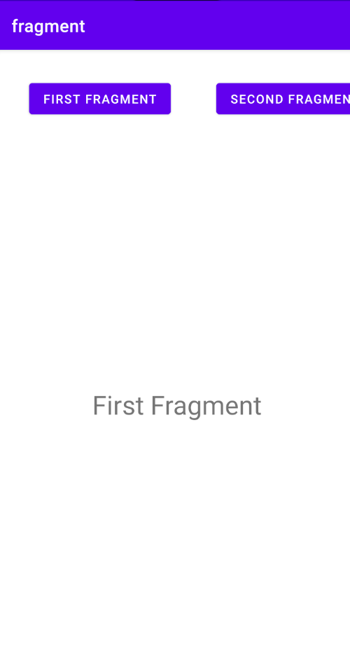
activity_main.XML
<fragment android:name="com.example.fragment.FirstFragment" android:id="@+id/fragment" android:layout_width="match_parent" android:layout_height="0dp" android:layout_marginTop="40dp" app:layout_constraintBottom_toBottomOf="parent" app:layout_constraintTop_toBottomOf="@+id/fragment1" tools:layout_editor_absoluteX="0dp" />
Set the first fragment as default, but fragment is static, we need something dynamic can be changed in running time, change fragment to FrameLayout, and change to be
<FrameLayout android:id="@+id/FLfragment" android:layout_width="match_parent" android:layout_height="0dp" android:layout_marginTop="40dp" app:layout_constraintBottom_toBottomOf="parent" app:layout_constraintTop_toBottomOf="@+id/fragment1" tools:layout_editor_absoluteX="0dp" />

Slide 17
MainActivity.kt
//initialize first fragment as default supportFragmentManager.beginTransaction().apply { replace(R.id.FLfragment, firstFragment) commit() } fragment1.setOnClickListener{ supportFragmentManager.beginTransaction().apply { replace(R.id.FLfragment, firstFragment) commit() } } fragment2.setOnClickListener{ supportFragmentManager.beginTransaction().apply { replace(R.id.FLfragment, secondFragment) commit() } } } }
package com.example.fragment import androidx.appcompat.app.AppCompatActivity import android.os.Bundle import android.widget.Button class MainActivity : AppCompatActivity() { override fun onCreate(savedInstanceState: Bundle?) { super.onCreate(savedInstanceState) setContentView(R.layout.activity_main) val firstFragment = FirstFragment() val secondFragment = SecondFragment() val fragment1: Button = findViewById(R.id.fragment1) val fragment2: Button = findViewById(R.id.fragment2)

Slide 18
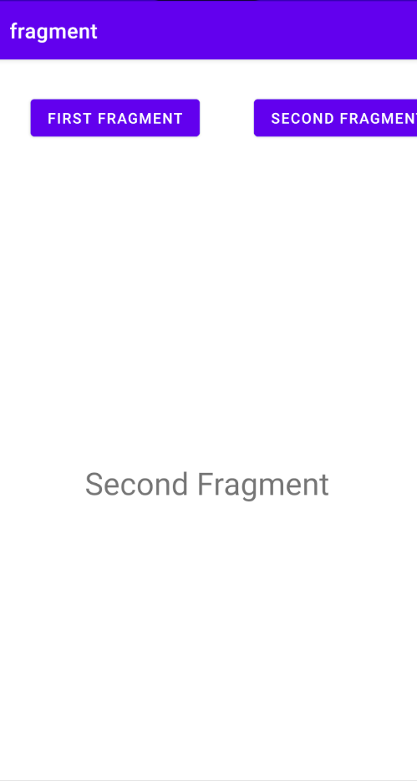
Let’s try switching

Slide 19
References
https://developer.android.com/guide/topics/ui/declaring-layout
https://www.tutorialkart.com/kotlin-android/kotlin-android-linearlayout-orientation-horizontal/
https://www.youtube.com/watch?v=-vAI7RSPxOA

